Slide 1



Netflix Data Analysis
Presented by
Navyasree Sriramoju
Hyun Joo Lee
CIS 5550
California State University of Los Angeles

Slide 2
1. Introduction
2. Data Collection
3. Data Cleaning
4. Visualizations
5.Methodology
6. Key Findings
Index

Slide 3
Introduction
Netflix is a popular streaming service that offers a vast catalog of movies, TV shows, and original contents.
This Dataset consist of contents added to Netflix from 2008 to 2021.
Includes columns like movie/TV show titles, release year, category, directors, cast, country, and ratings
Dataset link : https://www.kaggle.com/datasets/shivamb/netflix-shows

Slide 4
Data Collection
This Dataset is collected from Kaggle
Reasons to choose this Dataset:
Contains Diverse Fields.
To analyze Content Trends and Netflix Strategy Evolution.
Enhancing Skills Through Data Cleaning, Exploration, and Visualization.

Slide 5
For Data Cleaning we have used
the below Methods:
Data Cleaning
Treat the Nulls
Populate Missing Rows
Treat the Duplicates
Drop unneeded columns
Split Columns

Slide 6
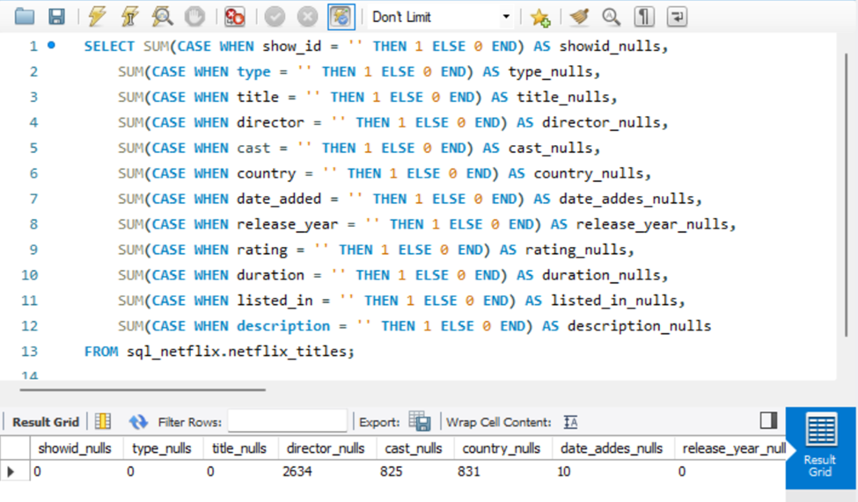
Treat the Nulls
We can see that there are NULLS.
director_nulls = 2634
cast_nulls = 825
country_nulls = 831
date_added_nulls = 10
rating_nulls = 4
duration_nulls = 3

Slide 7
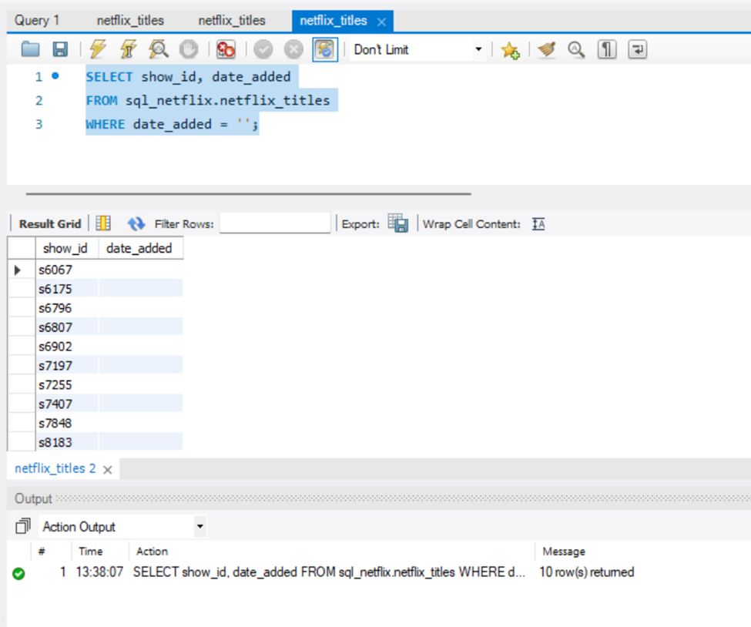
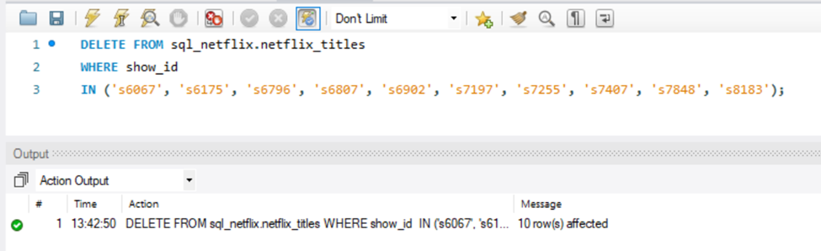
Treat the Nulls
The date_added and rating rows nulls are below 10 out of over 8000 rows, deleting them cannot affect our analysis or visualization

Slide 8
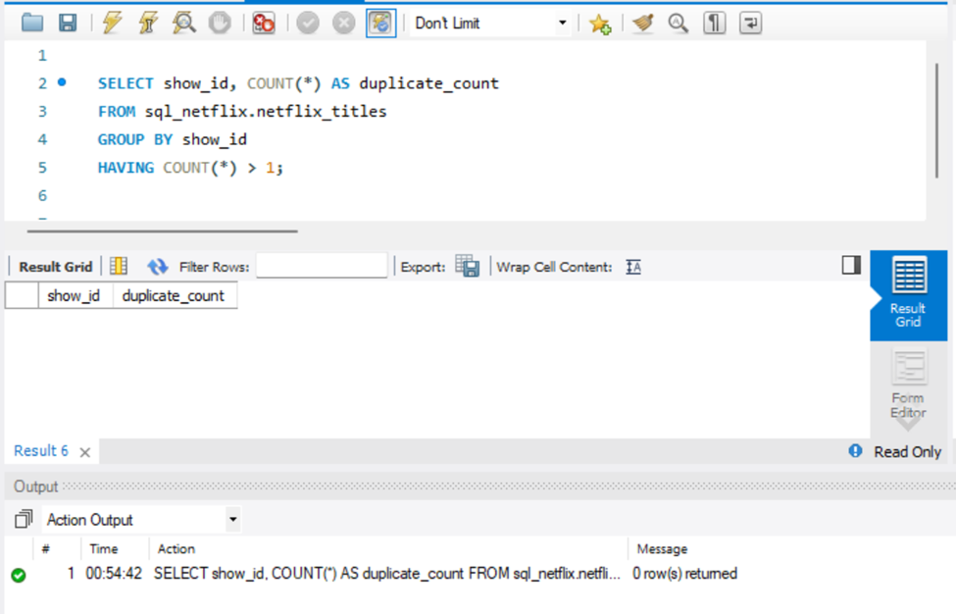
Treat the duplicates
No Duplicates Found in the
Dataset

Slide 9
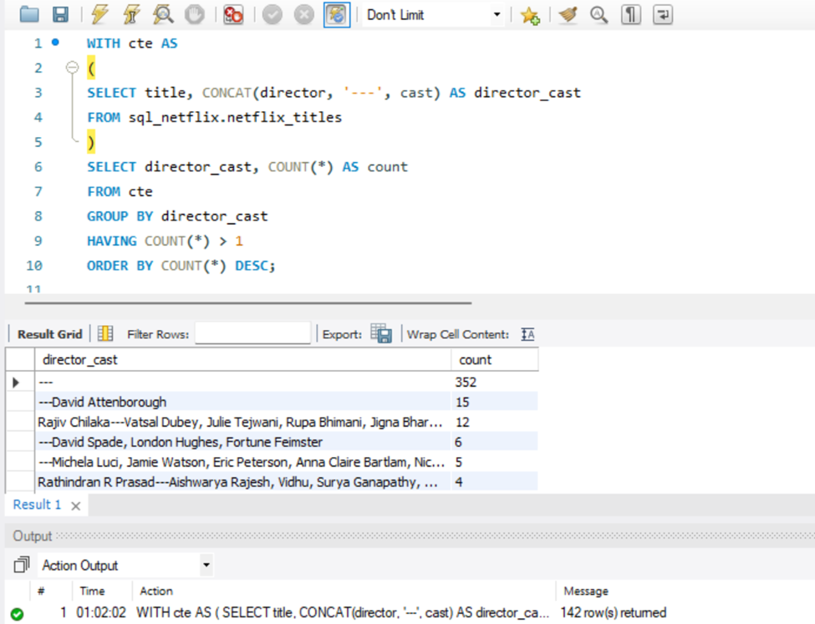
Populate the Rows
We found Null Values in multiple Rows, The director column nulls is about 30% of the whole column, therefore instead of deleting them. we rather find another column to populate it. To populate the director column, we want to find out if there is relationship between movie_cast column and director column

Slide 10
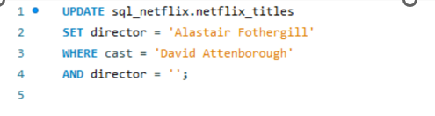
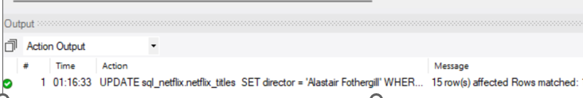
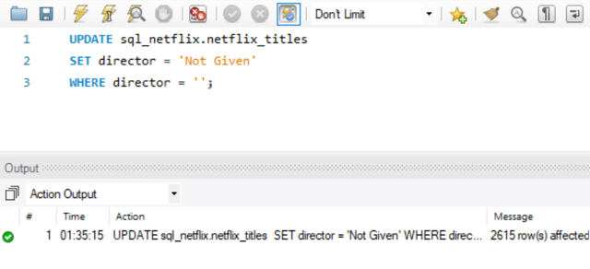
Populate the Rows
With the output from before Query, We updated the Director Column by comparing Cast members
Repeated this step to populate the rest of the director nulls.
Populate the rest of the NULL in director as "Not Given“.

Slide 11
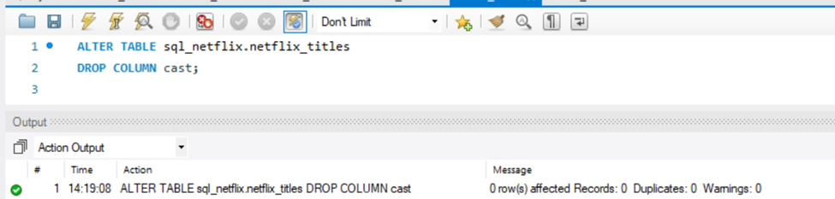
Delete Unnecessary Columns
We have dropped the movie cast column because there are multiple names in each row and may not be useful for the analysis.

Slide 12
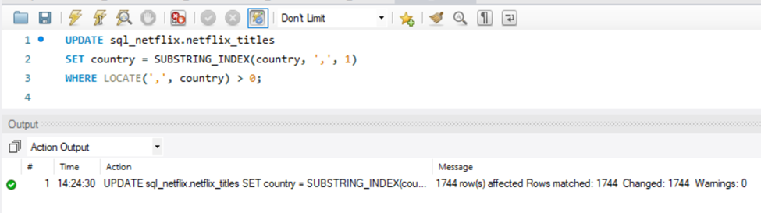
Split columns
Some of the rows in country column has multiple countries, for visualization, only one country is needed per row to make map visualization clean and easy. Therefore, splitting the country column and retain the first country by the left which would be the original country of the movie.

Slide 13
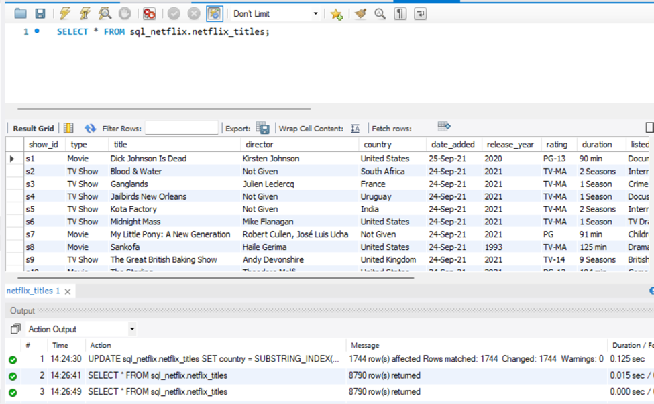
Split columns
Now we can see that there is only one country in the Country column

Slide 14
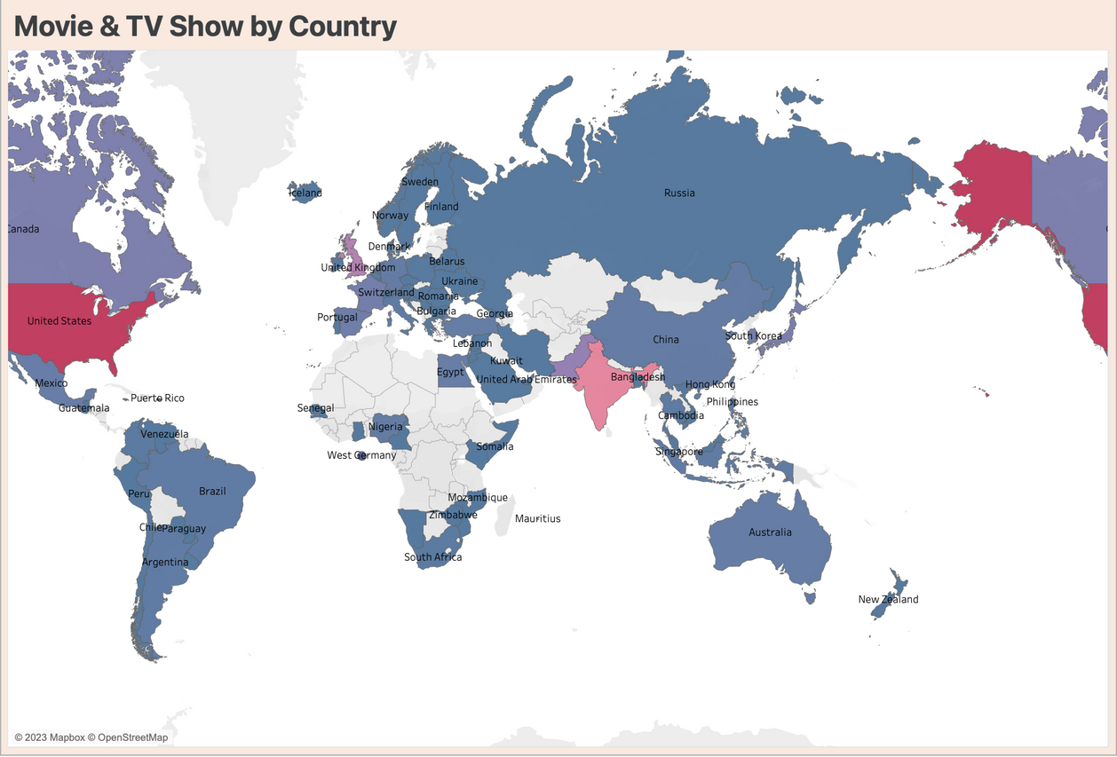
Data Visualization - Map Chart
Map Colors Indicate Viewership by Country Red for High Popularity
Blue for Lower Popularity.
Red Regions:
Well-Served by Current Content
Blue Regions:
May Require Tailored Strategies

Slide 15
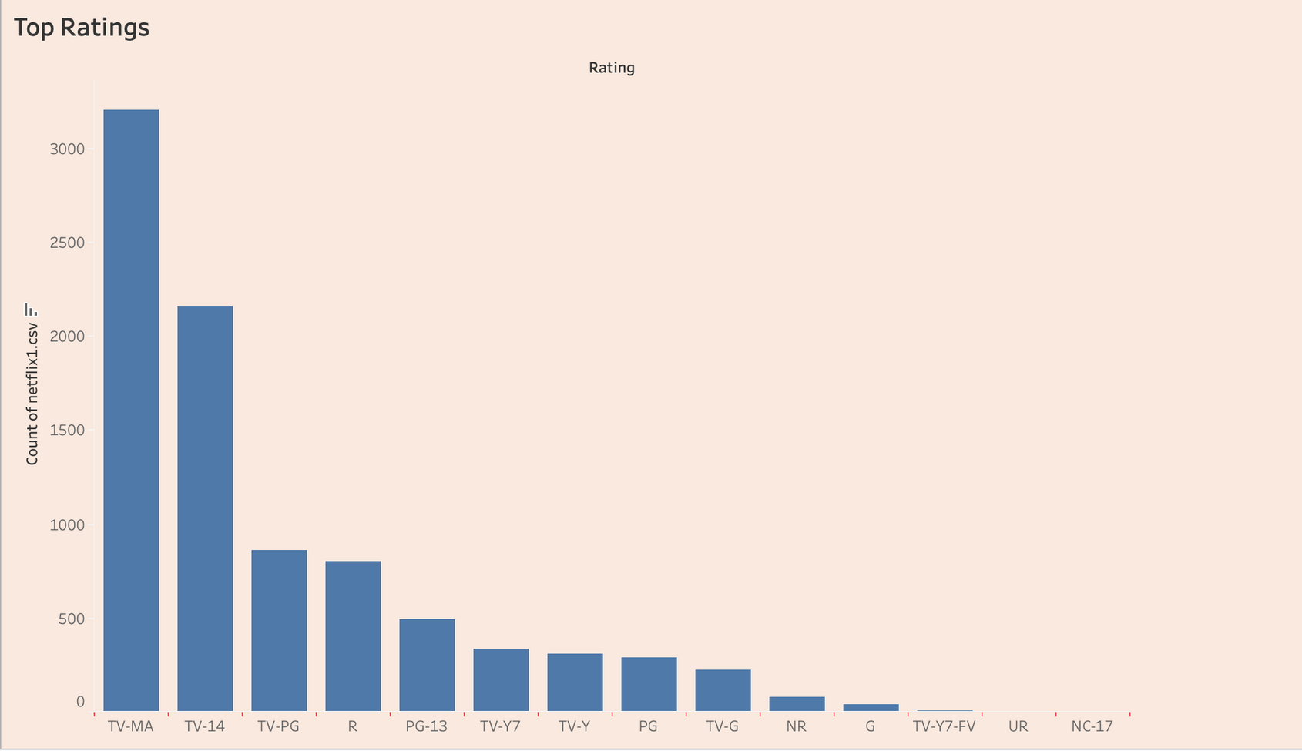
Data Visualization - Bar Chart
The most prominent bar is TV-MA-rated meaning that significant portion of Netflix's catalog is crafted for an adult audience.
Reflects Netflix's Focus on Adult Demographic, Matching Majority Subscriber Preferences.

Slide 16
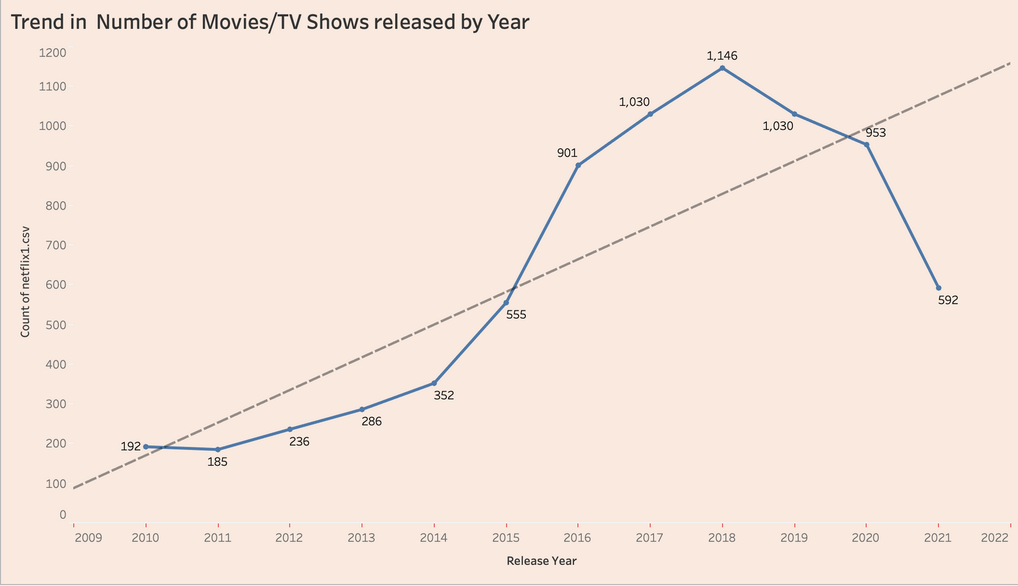
Data Visualization - Line Chart
Peak was 2018,
2021 Shows Sharp Decline to 592 Titles, Likely Due to COVID-19 Impact on Global Entertainment Industry.
The groundwork for analyzing the impact of external factors on content release patterns.

Slide 17
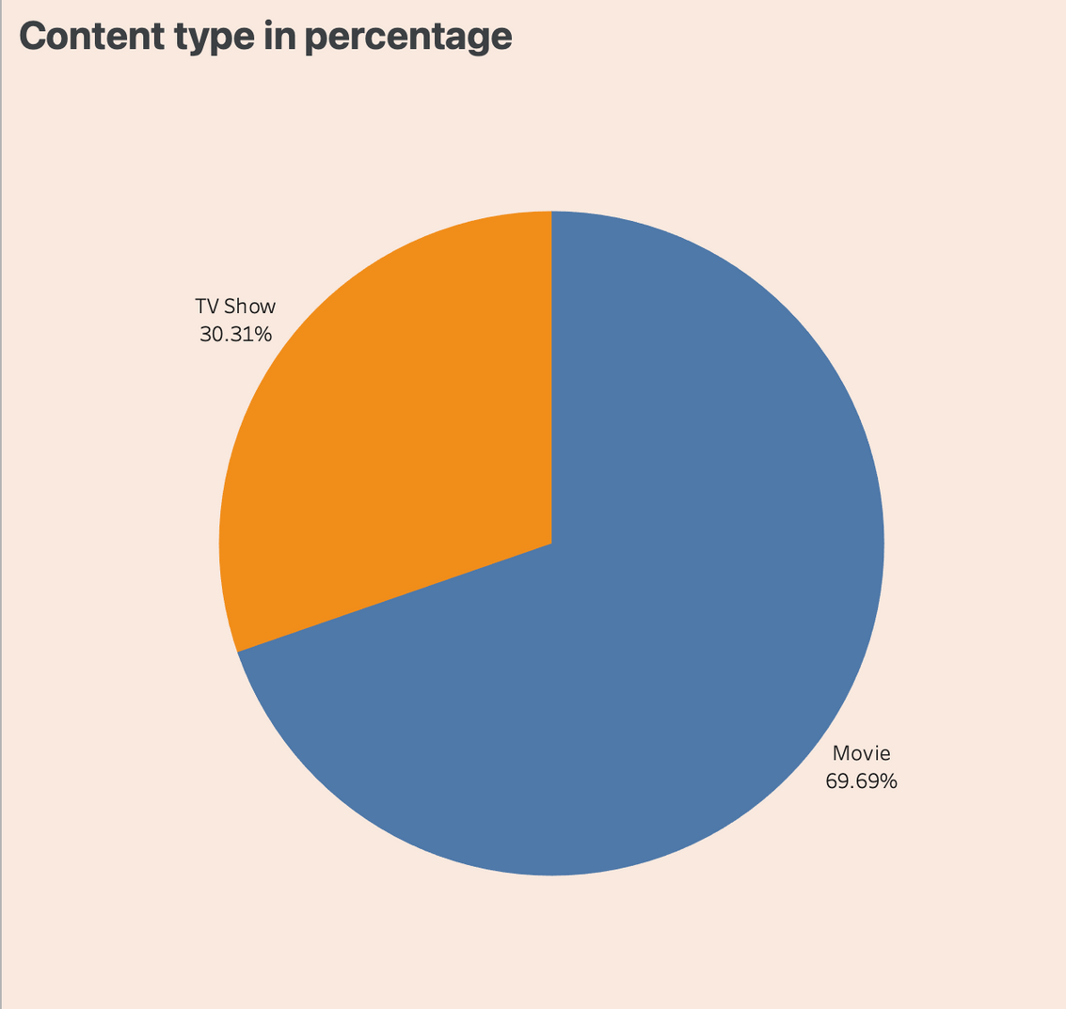
Data Visualization
-Pie Chart
Movies are predominant, while TV series are less numerous
Movies: Standalone & Abundant TV Series: Multi-Episode Resource: Intensive

Slide 18
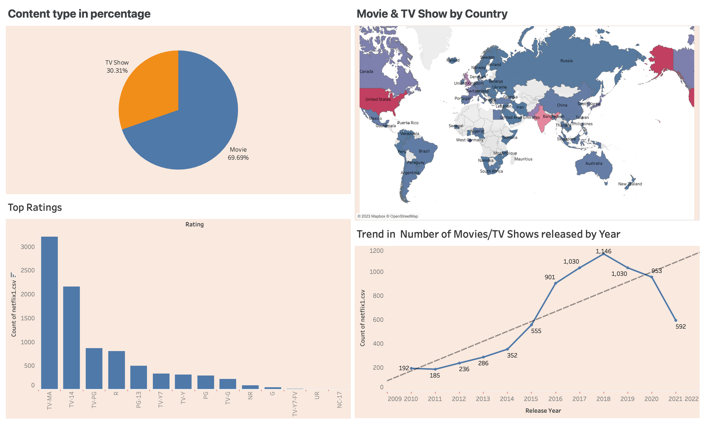
Dashboard

Slide 19
Methodology
Data Collection
Data Conversion
Data Visualization
Data Cleaning

Slide 20
Methodology
Dataset is CSV Format, We converted it into json Format and imported the Dataset into MySQL Workbench Editor.
Data consists of irregularities, with the majority occurring in Director Column.
Performed the Data Cleaning with SQL by using functions like JOIN, GROUP by, and HAVING etc.
Removed all the Null Values by populating the Rows, deleting the unneeded columns and we also Split the Columns for convenience in Data Analysis.
The cleaned was then extracted into Tableau and Implemented the Visualizations for Data Analysis and used Charts like Pie Cart, Map, Line Graph, and Bar Graph.

Slide 21


Key Findings/Recommedations
Content Strategy Refinement
Localized Content Strategies
Demographic Targeting

Slide 22
Thank You
For your Attention

